Slide 1
Normal Probability Distributions

Slide 2
The Normal Distribution
A normal distribution is a continuous frequency density that is a particular type of symmetric bell-shaped curve.
Because the curve has a single peak and is symmetric about this peak, its mode, median, and mean values coincide at this peak.
Most observed values lie relatively “close” (in way that is made more specific below) to the center of distribution, and their density falls off on either side of peak.

Slide 3
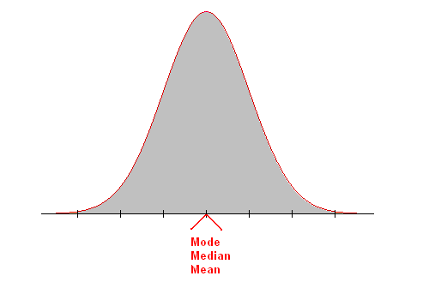
A Normal Curve

Slide 4
Normal Curve
The shape of the distribution changes with only two parameters, σ and μ, so if we know these, we can determine everything else.

Slide 5
Properties of Normal Distributions
Properties of a Normal Distribution
The mean, median, and mode are equal.
The normal curve is bell-shaped and symmetric about the mean.
The total area under the curve is equal to one.

Slide 6
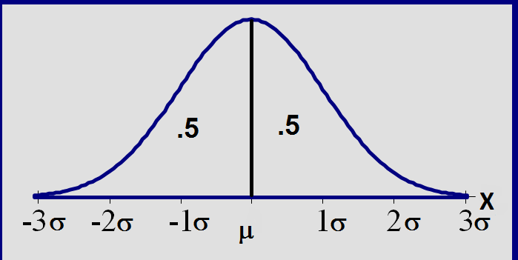
Total area =1; symmetric around µ

Slide 7
The effects of μ and σ
How does the standard deviation affect the shape of f(x)?
σ= 2
σ =3
σ =4
How does the expected value affect the location of f(x)?
μ = 10
μ = 11
μ = 12

Slide 8
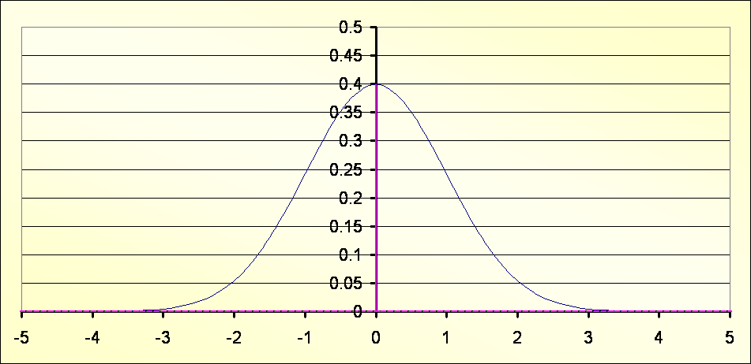
The normal distribution is a theoretical probability.
the area under the curve adds up to one

Slide 9
The normal distribution is a theoretical probability
A Normal distribution is a theoretical model of the whole population. It is perfectly symmetrical about the central value; the mean μ represented by zero.

Slide 10
As well as the mean the standard deviation (σ) must also be known.
The X axis is divided up into deviations from the mean. Below the shaded area is one deviation from the mean.

Slide 11
Two standard deviations from the mean

Slide 12
Three standard deviations from the mean

Slide 13
The 68%-95%-99.7% Rule 68% of data will fall within 1σ of the μ
P( | -1 | < | z | < | 1 | ) | = | 0.683 | = | 68.3%

Slide 14
95% of data fits within 2σ of the μ
P( | -2 | < | z | < | 2 | ) | = | 0.954 | = | 95.4%

Slide 15
99.7% of data fits within 3σ of the μ
P( | -3 | < | z | < | 3 | ) | = | 0.997 | = | 99.7%

Slide 16
The 68%-95%-99.7% Rule
We can state what is called the [approximate] 68%-95%-99.7% rule of the normal distribution. The rule is this:
about 68% of all observed values lie within one SD of the mean,
about 95% lie within two SDs of the mean, and
about 99.7% (that is, virtually all) lie within three SDs of the mean.

Slide 17
f(x)
P(a < X < b)
f(x)
P(a < X < b)
Probabilities:
area under
graph of f(x)
X
a
b
P(a < x < b) = area under the density curve between a and b.
P(a < x < b) = P(a < x < b)
P(X=a) = 0

Slide 18
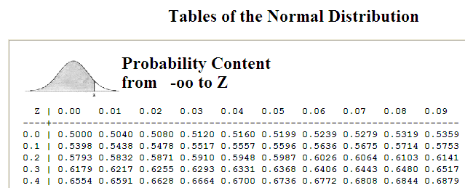
Luckily you don’t have to use the equation each time and you don’t have to integrate it every time you need to work out the normal distribution probability - the area under the curve
There are normal distribution tables

Slide 19
The Standard Normal Table
Example:
Find P(z < 2.71)
Appendix B: Standard Normal Table
z | .00 | .01 | .02 | .03 | .04 | .05 | .06 | .07 | .08 | .09
0.0 | .5000 | .5040 | .5080 | .5120 | .5160 | .5199 | .5239 | .5279 | .5319 | .5359
0.1 | .5398 | .5438 | .5478 | .5517 | .5557 | .5596 | .5636 | .5675 | .5714 | .5753
0.2 | .5793 | .5832 | .5871 | .5910 | .5948 | .5987 | .6026 | .6064 | .6103 | .6141
2.6 | .9953 | .9955 | .9956 | .9957 | .9959 | .9960 | .9961 | .9962 | .9963 | .9964
2.7 | .9965 | .9966 | .9967 | .9968 | .9969 | .9970 | .9971 | .9972 | .9973 | .9974
2.8 | .9974 | .9975 | .9976 | .9977 | .9977 | .9978 | .9979 | .9979 | .9980 | .9981
Find the probability by finding 2.7 in the left hand column, and then moving across the row to the column under 0.01.
P(z < 2.71) = 0.9966

Slide 20
The Standard Normal Table
Example:
Find P(z < −0.25)
Appendix B: Standard Normal Table
z | .09 | .08 | .07 | .06 | .05 | .04 | .03 | .02 | .01 | .00
−3.4 | .0002 | .0003 | .0003 | .0003 | .0003 | .0003 | .0003 | .0003 | .0003 | .0003
−3.3 | .0003 | .0004 | .0004 | .0004 | .0004 | .0004 | .0004 | .0005 | .0005 | .0005
−0.3 | .3483 | .3520 | .3557 | .3594 | .3632 | .3669 | .3707 | .3745 | .3783 | .3821
−0.2 | .3859 | .3897 | .3936 | .3974 | .4013 | .4052 | .4090 | .4129 | .4168 | .4207
−0.1 | .4247 | .4286 | .4325 | .4364 | .4404 | .4443 | .4483 | .4522 | .4562 | .4602
−0.0 | .4641 | .4681 | .4724 | .4761 | .4801 | .4840 | .4880 | .4920 | .4960 | .5000
Find the probability by finding −0.2 in the left hand column, and then moving across the row to the column under 0.05.
P(z < −0.25) = 0.4013

Slide 21
With a ClassPad you do not need to use the table. http://www.classpad.com.au/cp2/index.php?me=BA4&mn=470&mt=Normal_Probability_Calculations&my=awgngSed02c

Slide 22
Probability and Normal Distributions
Example:
The average on a statistics test was 78 with a standard deviation of 8. If the test scores are normally distributed, find the probability that a student receives a test score less than 90.
μ = 78
σ = 8
P(x < 90)
The probability that a student receives a test score less than 90 is 0.9332.
x
μ =78
90
z
μ =0
?
1.5
P(x < 90) = P(z < 1.5) = 0.9332

Slide 23
Probability and Normal Distributions
Example:
The average on a statistics test was 78 with a standard deviation of 8. If the test scores are normally distributed, find the probability that a student receives a test score greater than than 85.
μ = 78
σ = 8
P(x > 85)
The probability that a student receives a test score greater than 85 is 0.1908.
x
μ =78
85
z
μ =0
0.88
?
P(x > 85) = P(z > 0.88)
= 0.1908

Slide 24
Probability and Normal Distributions
Example:
The average on a statistics test was 78 with a standard deviation of 8. If the test scores are normally distributed, find the probability that a student receives a test score between 60 and 80.
P(60 < x < 80)
μ = 78
σ = 8
The probability that a student receives a test score between 60 and 80 is 0.5865.
x
60
μ =78
80
z
−2.25
μ =0
0.25
?
?
P(60 < x < 80) = P (−2.25 < z < 0.25)
= 0.5865

Slide 25
Finding z-scores

Slide 26
Finding z-Scores
Example:
Find the z-score that corresponds P(z < k) = 0.9973.
Appendix B: Standard Normal Table
z | .00 | .01 | .02 | .03 | .04 | .05 | .06 | .07 | .08 | .09
0.0 | .5000 | .5040 | .5080 | .5120 | .5160 | .5199 | .5239 | .5279 | .5319 | .5359
0.1 | .5398 | .5438 | .5478 | .5517 | .5557 | .5596 | .5636 | .5675 | .5714 | .5753
0.2 | .5793 | .5832 | .5871 | .5910 | .5948 | .5987 | .6026 | .6064 | .6103 | .6141
.08
2.6 | .9953 | .9955 | .9956 | .9957 | .9959 | .9960 | .9961 | .9962 | .9963 | .9964
2.7 | .9965 | .9966 | .9967 | .9968 | .9969 | .9970 | .9971 | .9972 | .9973 | .9974
2.8 | .9974 | .9975 | .9976 | .9977 | .9977 | .9978 | .9979 | .9979 | .9980 | .9981
2.7
Find the z-score by locating 0.9973 in the body of the Standard Normal Table. The values at the beginning of the corresponding row and at the top of the column give the z-score.
The z-score is 2.78.

Slide 27
Finding z-Scores
Example:
Find the z-score that corresponds to P(z < k) = 0.4170.
Appendix B: Standard Normal Table
z | .09 | .08 | .07 | .06 | .05 | .04 | .03 | .02 | .01 | .00
−3.4 | .0002 | .0003 | .0003 | .0003 | .0003 | .0003 | .0003 | .0003 | .0003 | .0003
−0.2 | .0003 | .0004 | .0004 | .0004 | .0004 | .0004 | .0004 | .0005 | .0005 | .0005
.01
Use the closest area.
−0.3 | .3483 | .3520 | .3557 | .3594 | .3632 | .3669 | .3707 | .3745 | .3783 | .3821
−0.2 | .3859 | .3897 | .3936 | .3974 | .4013 | .4052 | .4090 | .4129 | .4168 | .4207
−0.1 | .4247 | .4286 | .4325 | .4364 | .4404 | .4443 | .4483 | .4522 | .4562 | .4602
−0.0 | .4641 | .4681 | .4724 | .4761 | .4801 | .4840 | .4880 | .4920 | .4960 | .5000
−0.2
Find the z-score by locating 0.4170 in the body of the Standard Normal Table. Use the value closest to 0.4170.
The z-score is −0.21.

Slide 28
Once again with a ClassPad you do not need to use the table. http://www.classpad.com.au/cp2/index.php?me=BA4&mn=081&mt=Inverse_Normal_Probability_Calculations&my=3VFcgs8Mp40

